Slide 1


Zoup Restaurant App
Sutharshanagayathri U S
A_ID:901522​
Batch:2

Slide 2

Tech Stack
UI (client) - Flutter
Backend (server) - Nodejs,
Database - MongoDB

Slide 3

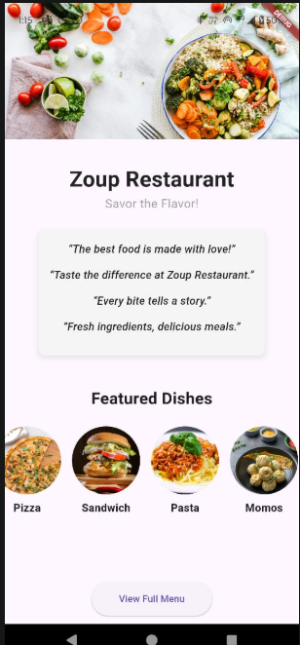
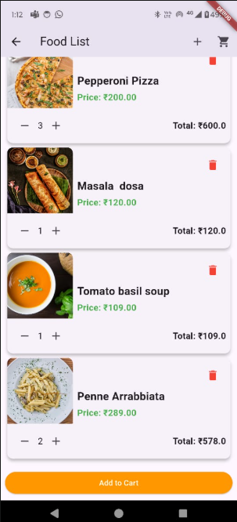
1.Home Page
2.Food List Screen

Slide 4

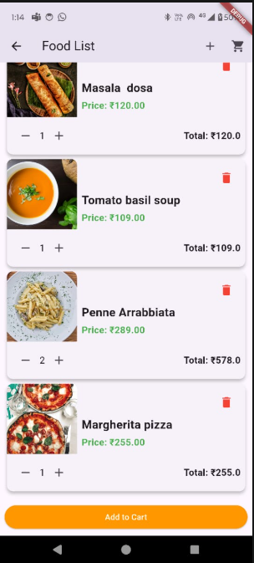
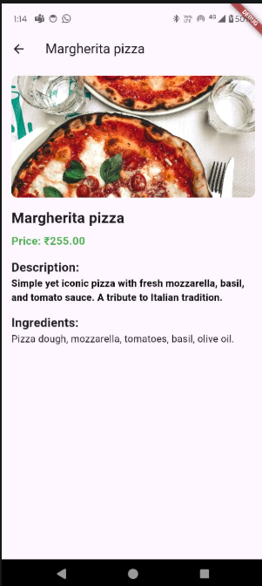
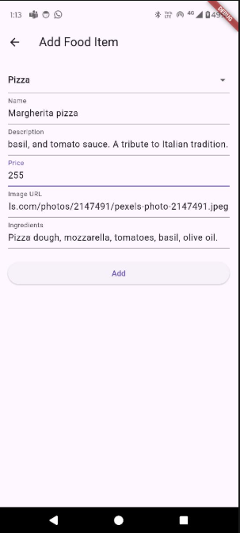
3.Add items

Slide 5
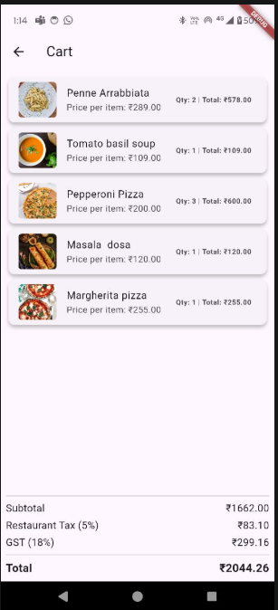
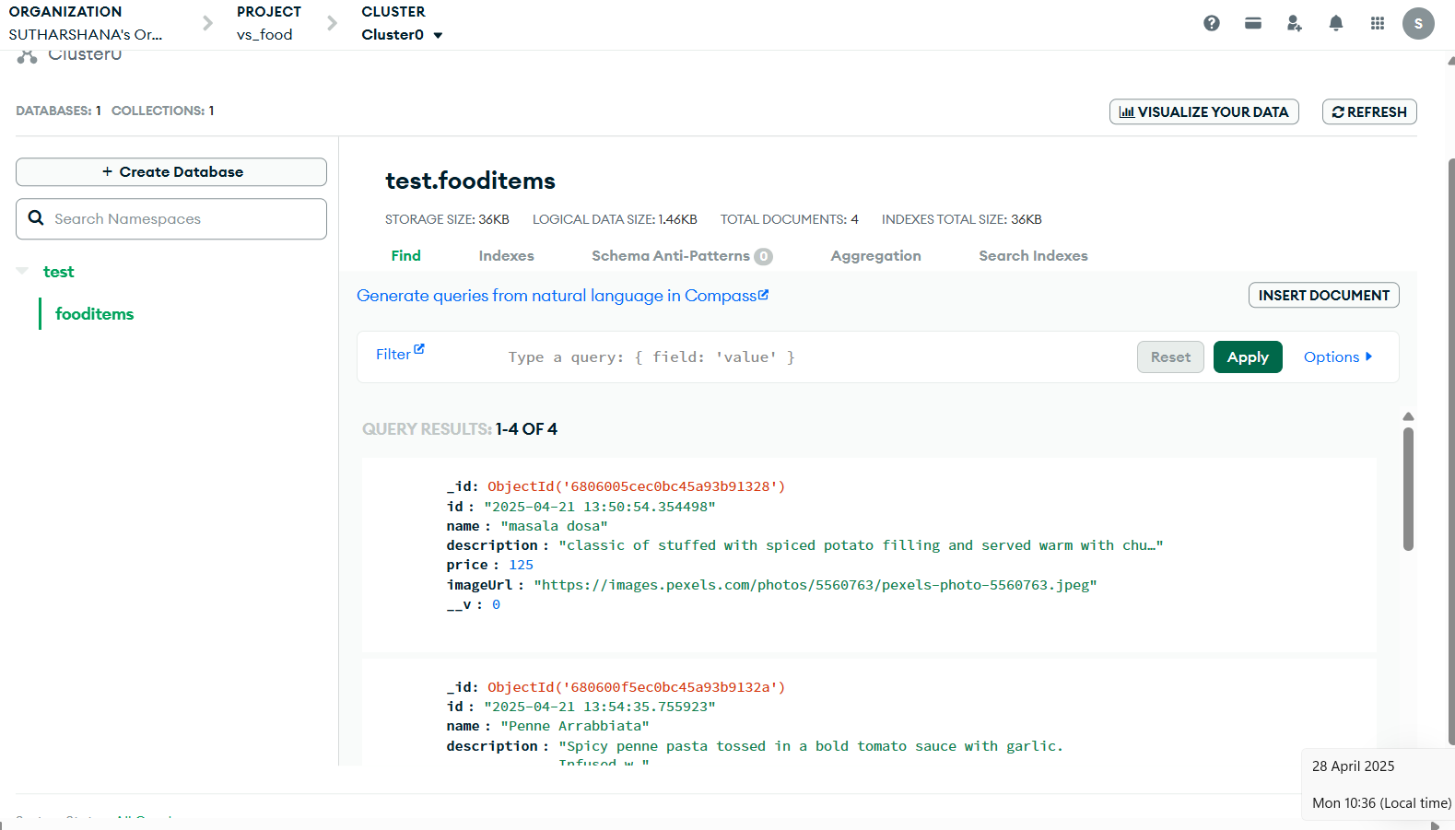
4. Cart Page:
5.Database

Slide 6
Github link
Thank you

